Slide 1
Sometimes we need to perform an action more than once
Pour a cup of coffee for each guest
Wash the dishes until they are all clean
Make a name card for each guest attending a party

Slide 2
In code, we use loops to repeat a task
We are going to have some fun in this module by drawing objects
We will use loops to draw some of our objects

Slide 3
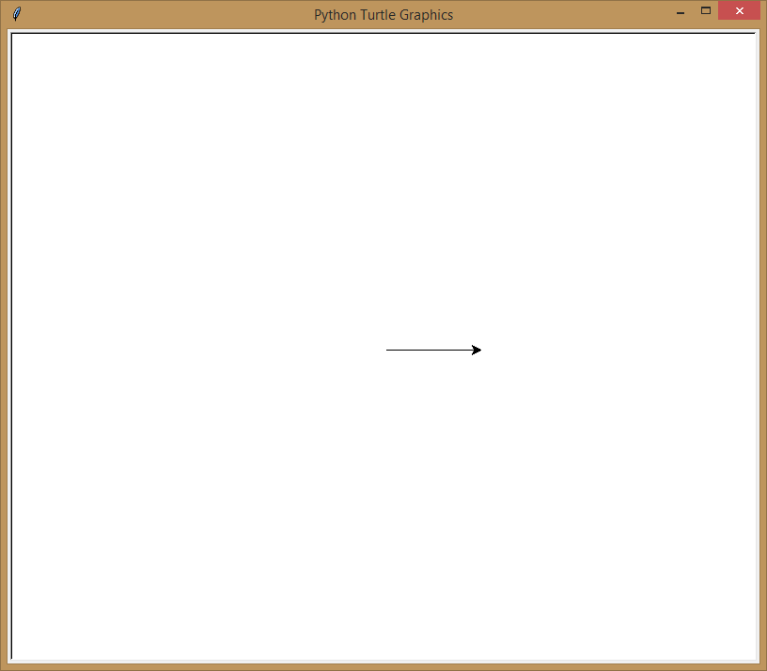
Did you know Python can draw?
import turtle
turtle.forward(100)

Slide 4

turtle is a library that lets you draw
import turtle
turtle.color('green')
turtle.forward(100)
turtle.right(45)
turtle.color('blue')
turtle.forward(50)
turtle.right(45)
turtle.color('pink')
turtle.forward(100)

Slide 5
Drawing with turtle

Slide 6
You can probably guess what some of the turtle commands do
Command | Action
right(x) | Rotate right x degrees
left(x) | Rotate left x degrees
color('x') | Change pen color to x
forward(x) | Move forward x
backward(x) | Move backward x

Slide 7
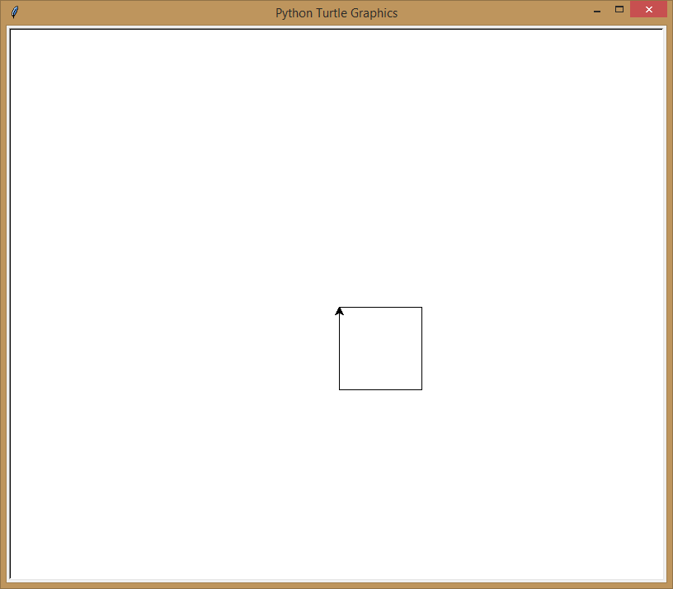
How would we get turtle do draw a square?
import turtle
turtle.forward(100)
turtle.right(90)
turtle.forward(100)
turtle.right(90)
turtle.forward(100)
turtle.right(90)
turtle.forward(100)
We are just repeating the same two lines of code

Slide 8
Loops allow us to repeat the same line of code as often as we want
Number of times to execute the code in the loop
import turtle
for steps in range(4):
turtle.forward(100)
turtle.right(90)
You MUST indent the code you want repeated

Slide 9
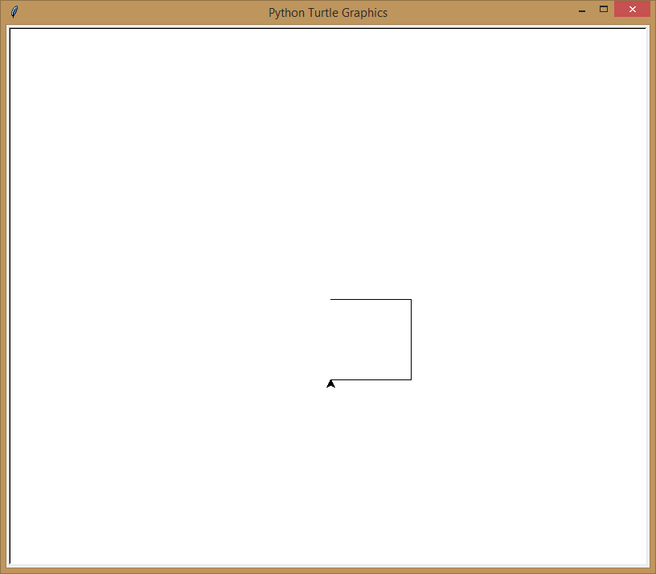
When you change the range, you change the number of times the code executes
Number of times to execute the code in the loop
import turtle
for steps in range(3):
turtle.forward(100)
turtle.right(90)

Slide 10
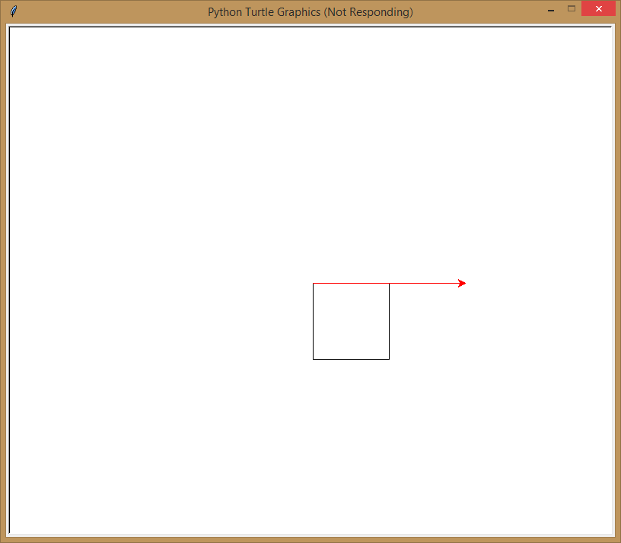
Only the indented code is repeated!
import turtle
for steps in range(4):
turtle.forward(100)
turtle.right(90)
turtle.color('red')
turtle.forward(200)

Slide 11
Using loops to draw shapes

Slide 12
Now we can make new typing mistakes!
Can you find three mistakes in this code?
improt turtle
for steps in range(4)
turtle.forward(100)
turtle.right(90)
import turtle
for steps in range(4):
turtle.forward(100)
turtle.right(90)

Slide 13
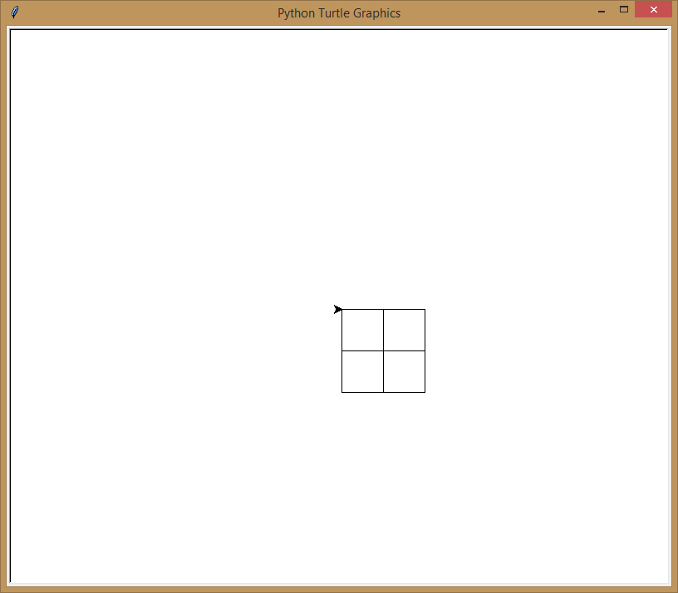
You can have lots of fun when you put a loop inside another loop!
import turtle
for steps in range(4):
turtle.forward(100)
turtle.right(90)
for moresteps in range(4):
turtle.forward(50)
turtle.right(90)

Slide 14
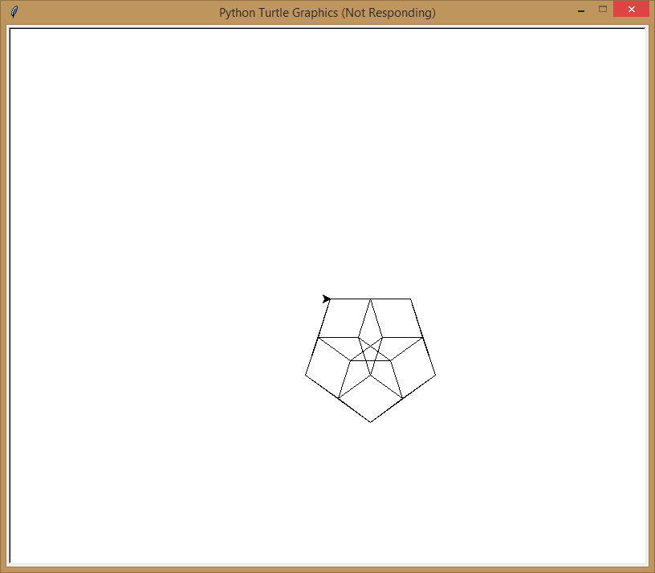
Just for fun
import turtle
for steps in range(5):
turtle.forward(100)
turtle.right(360/5)
for moresteps in range(5):
turtle.forward(50)
turtle.right(360/5)

Slide 15
Nested loops

Slide 16
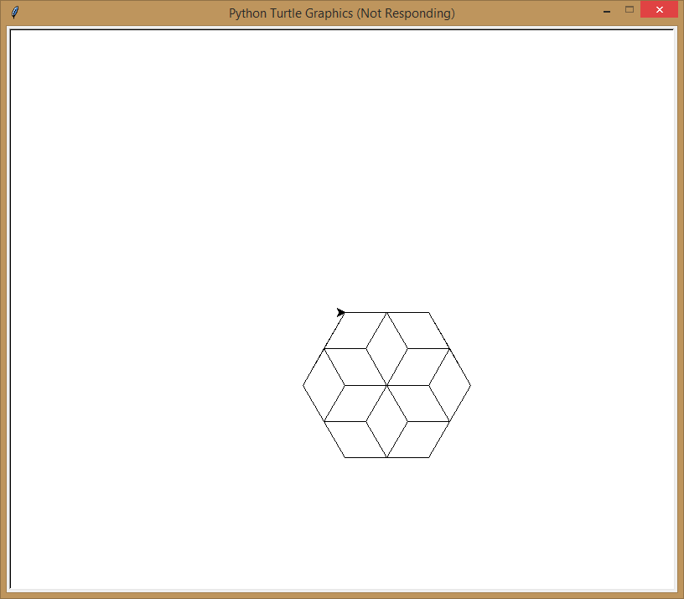
We could use a variable to decide the number of sides our object will have
import turtle
nbrSides = 6
for steps in range(nbrSides):
turtle.forward(100)
turtle.right(360/nbrSides)
for moresteps in range(nbrSides):
turtle.forward(50)
turtle.right(360/nbrSides)

Slide 17
What’s the advantage of using a variable here instead of just typing in the number?
import turtle
nbrSides = 6
for steps in range(nbrSides):
turtle.forward(100)
turtle.right(360/nbrSides)
for moresteps in range(nbrSides):
turtle.forward(50)
turtle.right(360/nbrSides)

Slide 18
When we use a variable and we want to change a value that appears in many places, we only have to update one line of code!
import turtle
nbrSides = 6
for steps in range(nbrSides):
turtle.forward(100)
turtle.right(360/nbrSides)
for moresteps in range(nbrSides):
turtle.forward(50)
turtle.right(360/nbrSides)
Now when we have to change our code,
we are less likely to make a mistake by forgetting to change one of the values

Slide 19
Using a variable in our loop

Slide 20
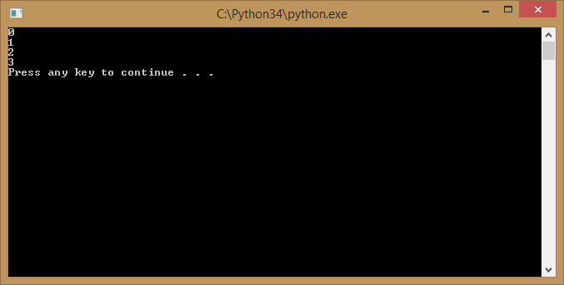
You can look at the loop values within the loop
for steps in range(4) :
print(steps)
Yes, counting starts at zero in for loops, that’s pretty common in programming

Slide 21
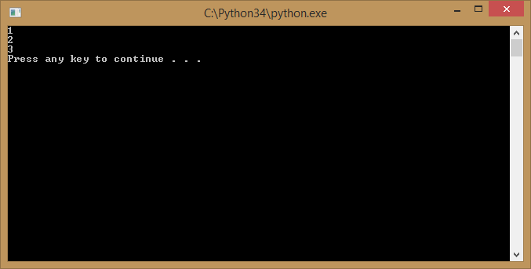
If you need to start counting from “1” you can specify numbers to count to and from
for steps in range(1,4) :
print(steps)
Did you notice this time the loop only executed three times?

Slide 22

You can also tell the loop to skip values by specifying a step
for steps in range(1,10,2) :
print(steps)

Slide 23

One of the cool things about Python is the way you can tell it exactly what values you want to use in the loop
for steps in [1,2,3,4,5] :
print(steps)
This requires using [ ] brackets instead of ( ) and you don’t use the “range” keyword

Slide 24
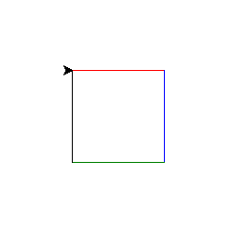
And you don’t have to use numbers!
import turtle
for steps in ['red','blue','green','black'] :
turtle.color(steps)
turtle.forward(100)
turtle.right(90)
What do you think this code will do?

Slide 25
Loop with random numbers
import random
for i in range(10):
x = random.random()
print x

Slide 26
Infinite loop
n = 10
while True:
print n,
n = n - 1
print 'Done!'

Slide 27
while True:
line = raw_input('> ')
if line == 'done':
break
print line print 'Done!'

Slide 28
Using an explicit list of values in your loop

Slide 29
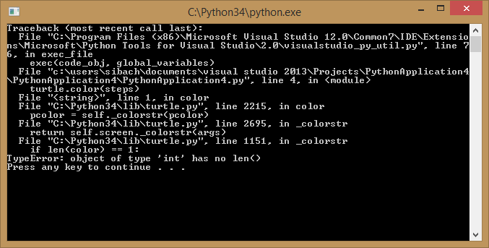
You can even mix up different datatypes (e.g. numbers and strings) but…
import turtle
for steps in ['red','blue','green','black',8] :
turtle.color(steps)
turtle.forward(100)
turtle.right(90)
You had better make sure any code using that value can handle the different datatypes!

Slide 30
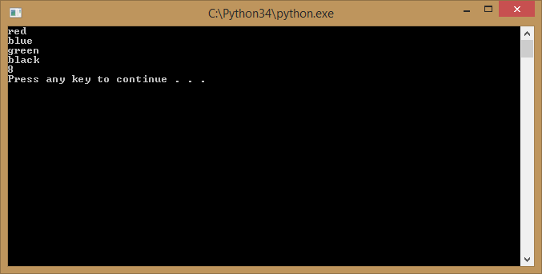
You can’t set the color to a number so the code crashed, but print can accept strings or numbers
for steps in ['red','blue','green','black‘,8] :
print (steps)

Slide 31
While Loop
loop= 0 count= 0 running_total= 0
while loop ==0:
inp= raw_input ("Enter a number:")
if inp== "done" or inp== "Done" :
break
try: num= float(inp)
except: print "Invalid input.
Please insert a number or type done to finish“
continue
count= count + 1
running_total= running_total + num
print count," numbers input“
print running_total," total"
print "and average:", running_total/count

Slide 32
si = 0 ci = 0
while True:
inp = raw_input("Enter a number: ")
if inp == 'done' :
break
try: num = float(inp)
si = si + num ci = ci + 1
except:
#this appears to also work for an unintended blank line of data as well.
print "Bad Data"
print "Sum:", si, "Count:", ci, "Mean:",si/ci

Slide 33
Your challenge
Get turtle to draw an octagon
Hint: to calculate the angle, you take 360 degrees and divide it by the number of sides of the shape you are drawing
Extra challenge: Let the user specify how many sides the object will have and draw whatever they ask
Double bonus challenge, add a nested loop to draw a smaller version of the object inside!

Slide 34
Congratulations
You can manage problems which require repeating the same task over and over a fixed number of times

